Slide 1
Bridging Technology and Strategy
A Data-Driven Approach
By Ashique Raza Hossain
Data Processing & Business Analysis (D3870)

Slide 2
The Hook - Why IT Matters
Information Technology transforms how modern businesses operate and compete.
It supports everything from routine daily operations to high-level strategic decision-making.

Slide 3
IT vs. Computer Science
Computer Science is the study of computation, algorithms, and software design.
Information Technology focuses on the use and management of networks and systems to process and share information.

Slide 4
The Core Components
Hardware and Software provide the physical and programmatic foundation.
Networking and Data connect systems and provide raw facts for processing.
People and Processes drive the workflows managing these systems.

Slide 5
IT's Strategic Impact
IT automates tasks to increase efficiency and reduce errors.
Advanced analytics tools allow businesses to make data-driven decisions.

Slide 6
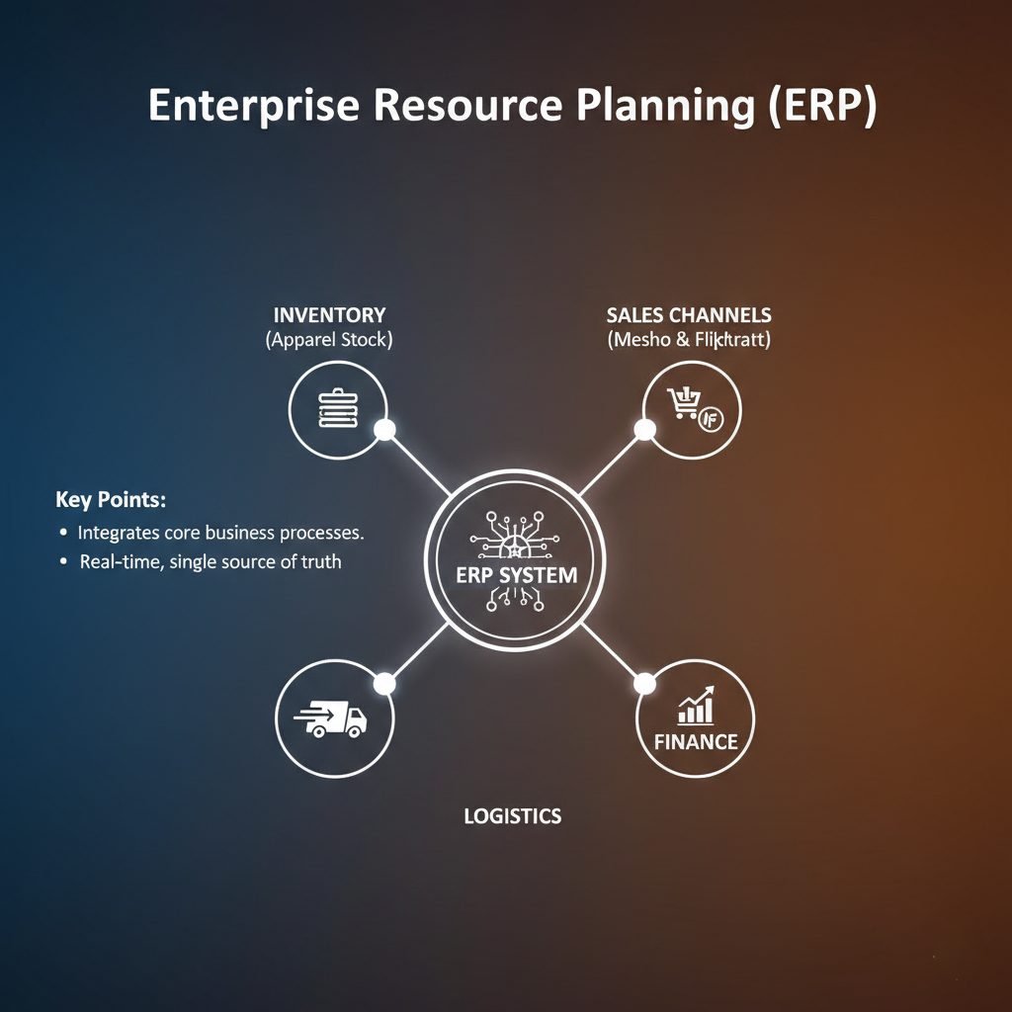
Enterprise Resource Planning (ERP)
ERP systems integrate core business processes into a single, unified platform.
By centralizing data, organizations gain a real-time, single source of truth.

Slide 7
ERP vs. CRM
ERP manages internal processes to reduce costs and streamline operations.
CRM focuses on customer-related activities to build relationships and increase sales.

Slide 8
Strategy Alignment
Business strategy sets the overall goals.
IT strategy defines how technology supports those goals.
Alignment capability ensures these two strategies are continuously coordinated.

Slide 9
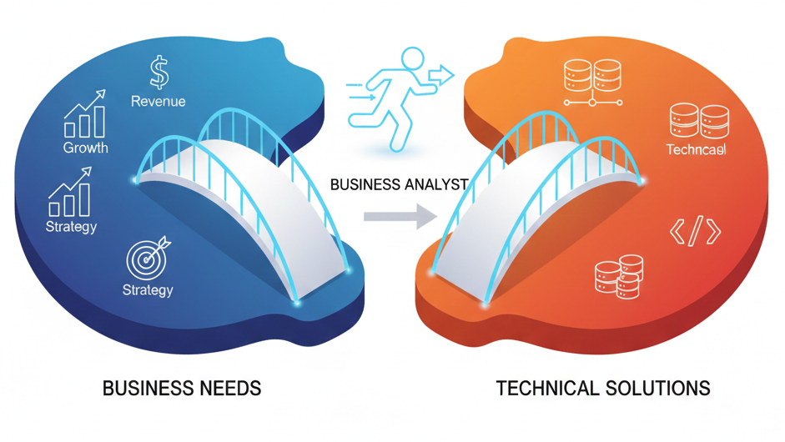
The Business Analyst Bridge
Business analysts act as a bridge between business needs and technical solutions.
They assess current processes and identify areas to increase efficiency and boost revenue.

Slide 10
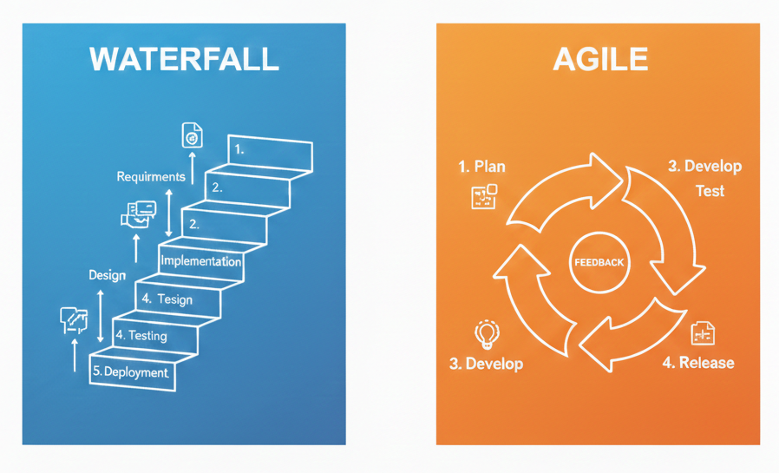
Execution Methodologies: Agile vs. Waterfall
Waterfall is a linear, sequential model requiring thorough upfront planning.
Agile is a flexible, iterative approach focusing on continuous feedback.

Slide 11
Choosing the Right Approach
Waterfall is best for projects with stable requirements and strict documentation needs.
Agile is ideal when requirements are likely to change and fast delivery is a priority.

Slide 12
Stakeholder Management
It involves identifying and engaging with individuals who affect or are affected by a project.
Managing their expectations helps build trust and increases project success.

Slide 13
Scenario Analysis
Scenario analysis evaluates different possible future situations (best, worst, most likely).
It helps businesses anticipate risks and supports strategic decision-making.

Slide 14
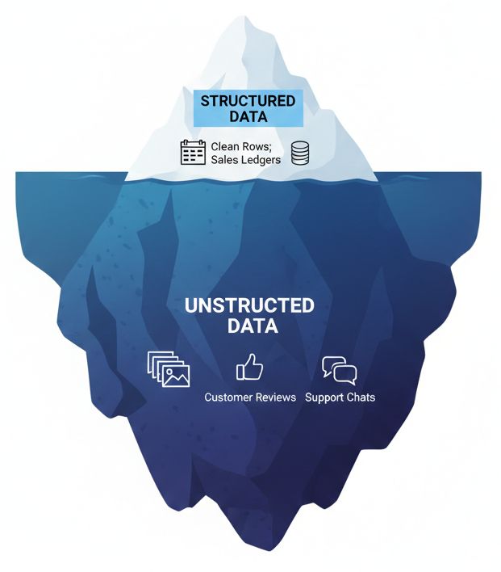
The Data Landscape
Structured data is highly organized in a fixed, tabular format.
Unstructured data has no predefined schema and makes up a large portion of real-world data.

Slide 15
Sourcing the Data
Internal data is generated during day-to-day operations.
Open data is freely available information often published by governments or institutions.

Slide 16
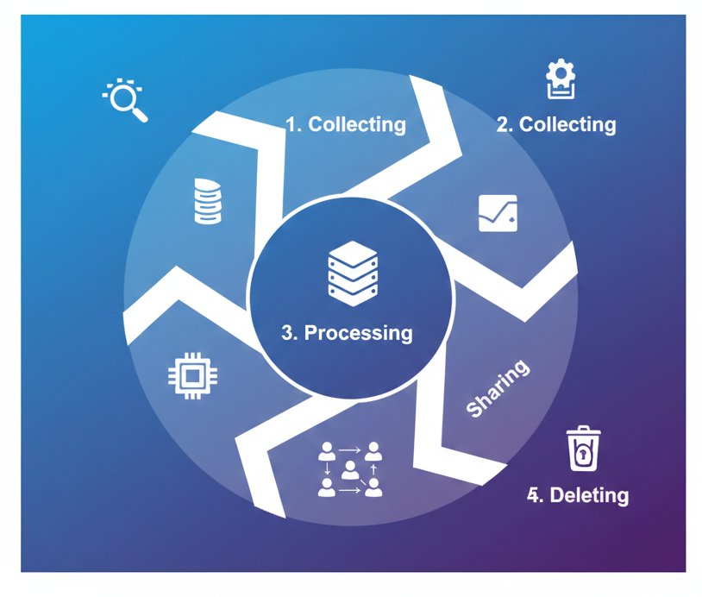
Data Lifecycle Management (DLM)
DLM handles data from the moment it is created until it is deleted or archived.
Phases include: Collecting, Storing, Processing, Sharing, and Deleting.

Slide 17
Data Governance
Governance relies on policies and rules to ensure data is correct, secure, and used responsibly.
It improves data quality, reducing errors and supporting better decision-making.

Slide 18
Ethical Data Use
Ethical use requires consent, transparency, and data minimization.
It involves actively identifying and mitigating biases to ensure fair, non-discriminatory outcomes.

Slide 19
Privacy Regulations (GDPR vs. CCPA)
Both frameworks aim to give individuals greater control over their personal data.
GDPR protects individuals in the EU, while CCPA focuses on permanent California residents.

Slide 20
Summary
Aligning IT with business strategy drives modern success.
Data governance and agile execution are key.
Technology is not a support cost; it is a primary driver of business competitive advantage.
Success in modern IT requires iterative delivery and rapid response to stakeholder feedback.
Managing data from collection to secure deletion is essential for compliance and trust.
Effective solutions require a "translator" who understands both Python and Profit margins.

